Slide 1
Language Processing System & compiler phases
Saja Almodhafar
15-12-2020
2

Slide 2
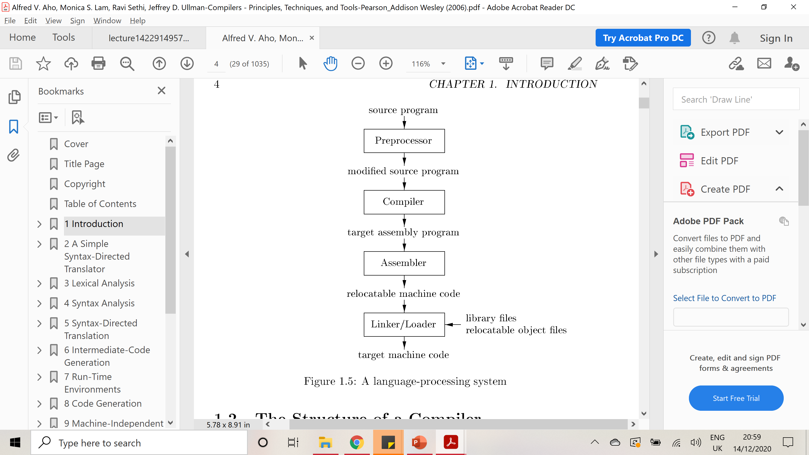
Language Processing System

Slide 3
preprocessor
A preprocessor produce input to compilers. They may perform the following functions.
1. Macro processing: A preprocessor may allow a user to define macros that are short hands for longer constructs.
2. File inclusion: A preprocessor may include header files into the program text.
3. Rational preprocessor: these preprocessors augment older languages with more modern flow-ofcontrol and data structuring facilities.
4. Language Extensions: These preprocessor attempts to add capabilities to the language by certain amounts to build-in macro

Slide 4
COMPILER
Compiler is a translator program that translates a program written in (HLL) (the source program) into an equivalent program in (MLL) the target program. As an important part of a compiler is error showing to the programmer.

Slide 5
ASSEMBLER
ASSEMBLER
Programmers found it difficult to write or read programs in machine language. They begin to use a mnemonic (symbols) for each machine instruction, which they would subsequently translate into machine language. Such a mnemonic machine language is now called an assembly language. Programs known as assembler were written to automate the translation of assembly language into machine language.
The input to an assembler program is called source program.
The output is a machine language translation (object program).

Slide 6
INTERPRETER
An interpreter is a program that appears to execute a source program as if it were machine language.
Languages such as BASIC, SNOBOL, LISP can be translated using interpreters. JAVA also uses
interpreter. The process of interpretation can be carried out in following phases.
1. Lexical analysis
2. Syntax analysis
3. Semantic analysis
4. Direct Execution

Slide 7
Advantages and disadvantage of interpreter
Advantages
Modification of user program can be easily made and implemented as execution proceeds.
Type of object that denotes a various may change dynamically.
Debugging a program and finding errors is simplified task for a program used for interpretation.
The interpreter for the language makes it machine independent.
Disadvantages:
The execution of the program is slower.
Memory consumption is more.

Slide 8
LOADER AND LINK-EDITOR:
loader is a program that places programs into memory and prepares them for execution.” It would be more efficient if subroutines could be translated into object form the loader could relocate directly behind the user’s program. The task of adjusting programs o they may be placed in arbitrary core locations is called relocation.

Slide 9
Phases of a compiler
A compiler operates in phases. A phase is a logically interrelated operation that takes source program in one representation and produces output in another representation.

Slide 10
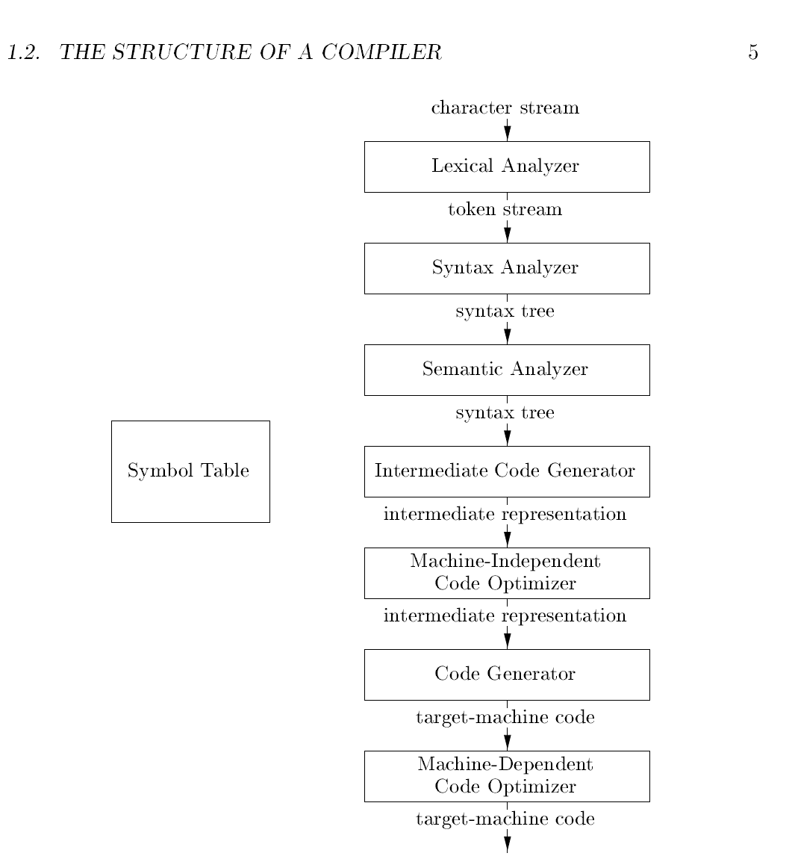

Slide 11
1- Lexical Analysis
The first phase of a compiler is called lexical analysis or scanning. The lexical analyzer reads the stream of characters making up the source program and groups the characters into meaningful sequences called lexemes. For each lexeme, the lexical analyzer produces output as a token of the form.
<token-name, attribute-value>
token-name is an abstract symbol that is used during syntax analysis.
attribute-value points to an entry in the symbol table for this token.
Information from the symbol-table entry 'is needed for semantic analysis and code generation.

Slide 12
example
For example, suppose a source program contains the assignment statement
position = initial + rate * 60
Blanks separating the lexemes would be discarded by the lexical analyzer.
The outputs of this phase for the above example is
<id,1> <=> <id,2> <+> <id,3> <*> <60>

Slide 13
2- Syntax Analysis
The second phase of the compiler is syntax analysis or parsing. The parser uses the first components of the tokens produced by the lexical analyzer to create
a tree-like intermediate representation that depicts the grammatical structure of the token stream. A typical representation is a syntax tree in which each interior node represents an operation and the children of the node represent the arguments of the operation.

Slide 14
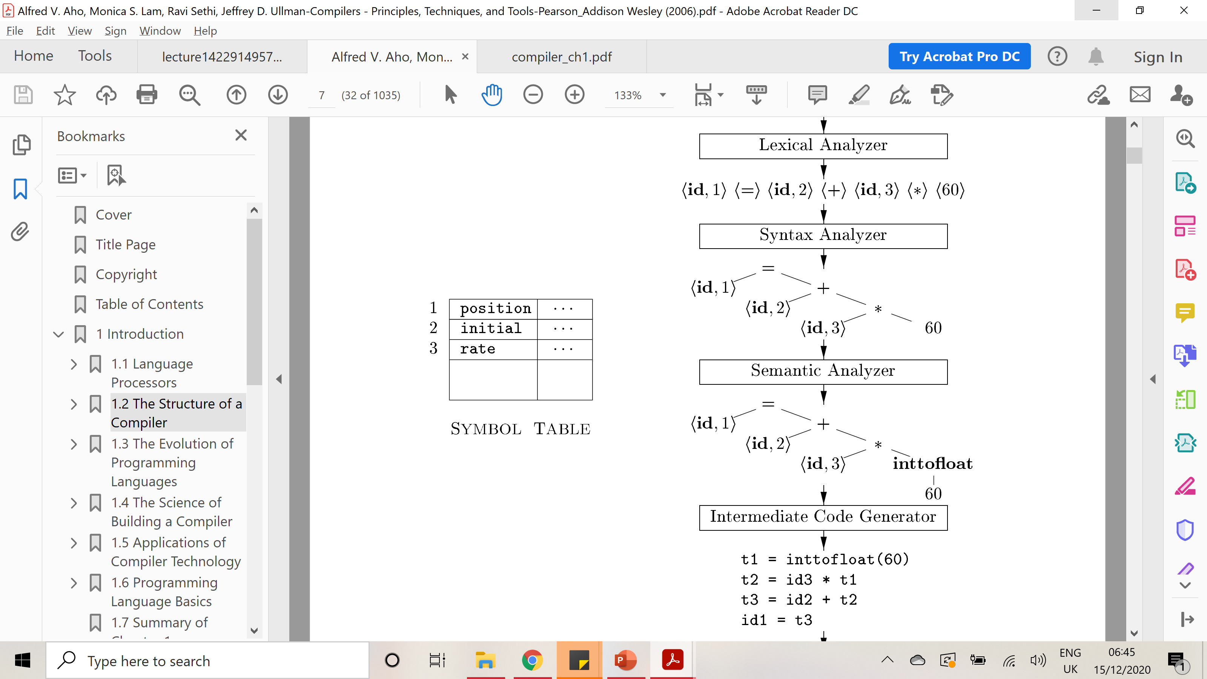
The output of this phase is shown in the following figure

Slide 15
3- Semantic Analysis
The semantic analyzer uses the syntax tree and the information in the symbol table to check the source program for semantic consistency with the language definition. It also gathers type information and saves it in either the syntax tree or the symbol table, for subsequent use during intermediate-code generation.
An important part of semantic analysis is type checking, where the compiler checks that each operator has matching operands.
For example, many programming language definitions require an array index to be an integer; the compiler must report an error if a floating-point number is used to index an array.

Slide 16
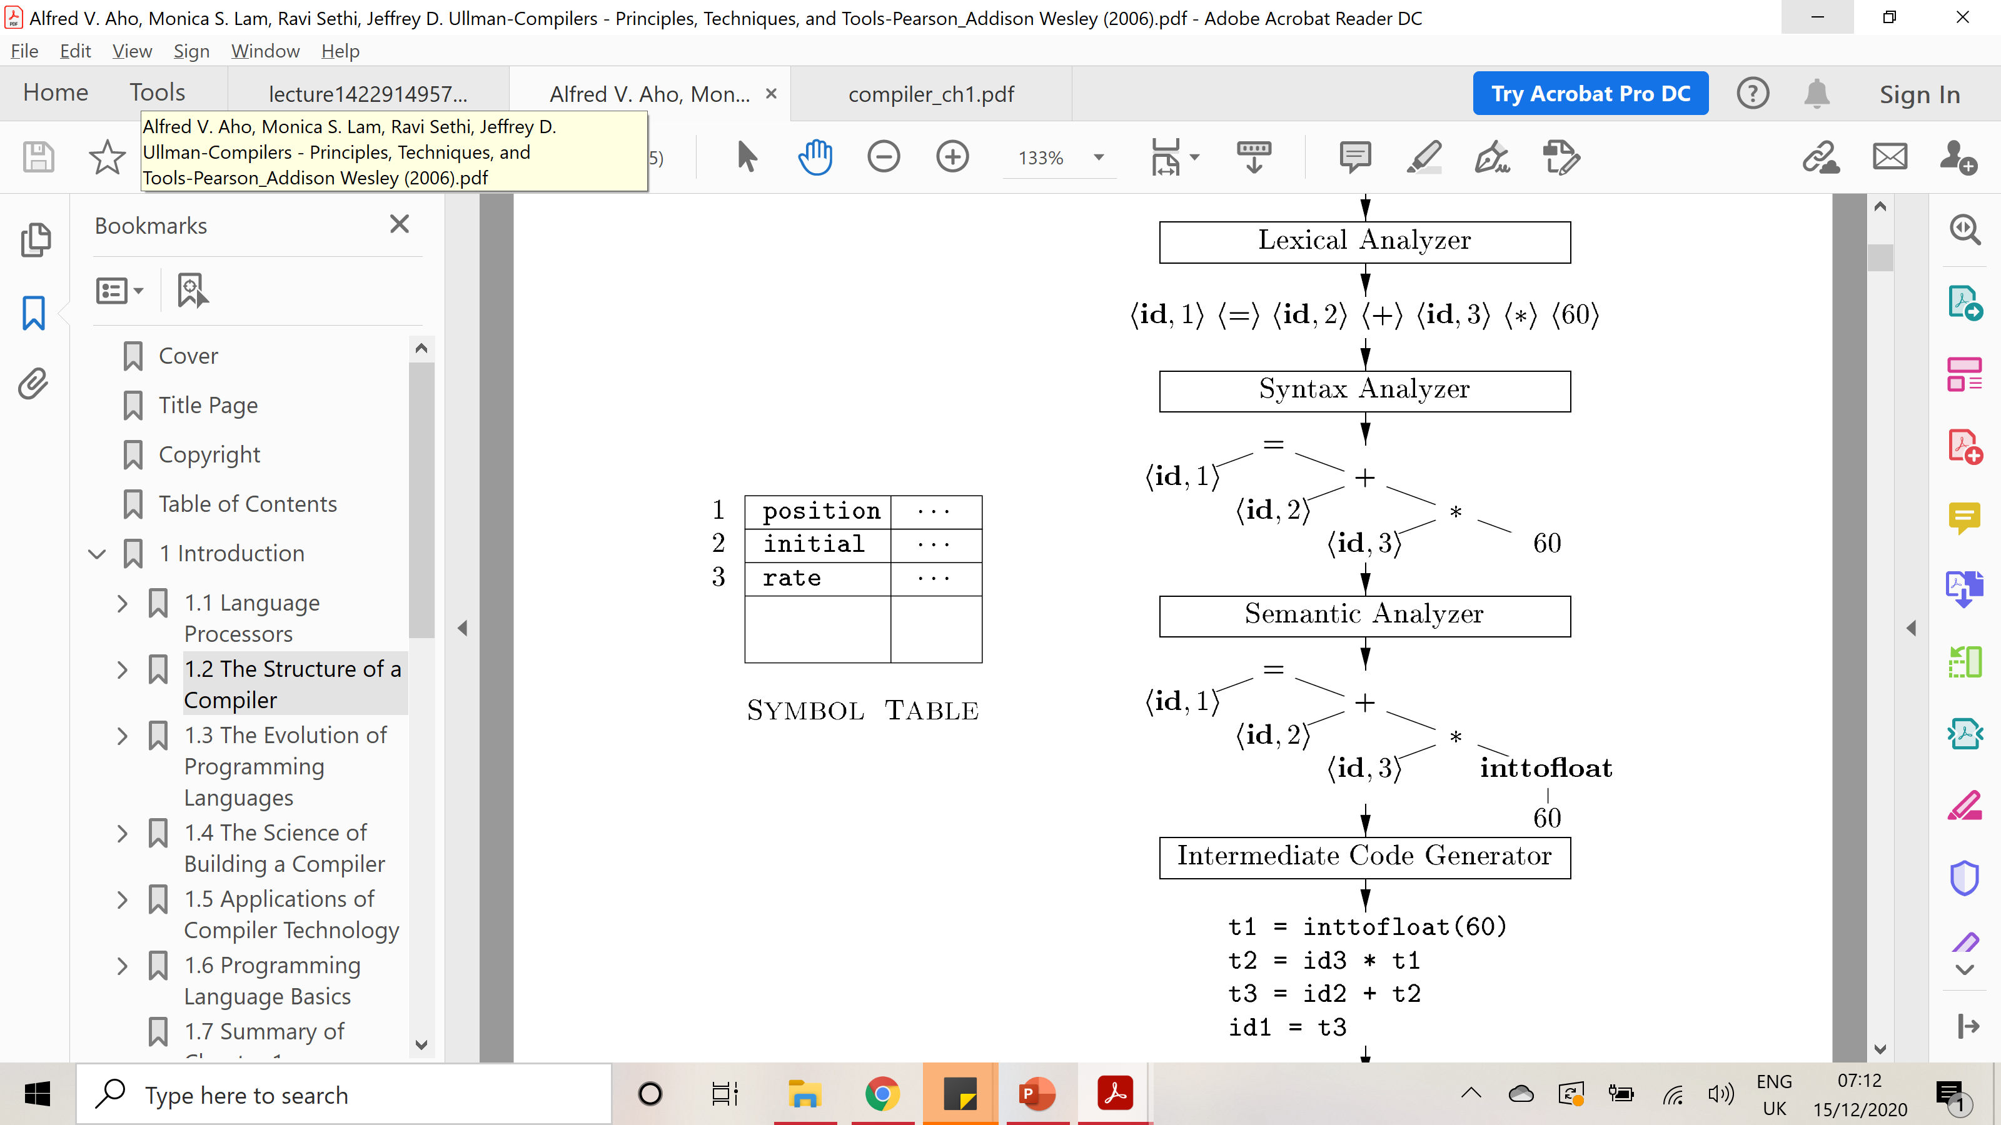
The language specification may permit some type conversions called coercions.
For example, a binary arithmetic operator may be applied to either a pair of integers or to a pair of floating-point numbers. If the operator is applied to a floating-point number and an integer, the compiler may convert or coerce the integer into a floating-point number.

Slide 17
4- Intermediate Code Generation
In the process a compiler may construct one or more intermediate representations, which can have a variety of forms. Such as trees
After syntax and semantic analysis of the source program, many compilers generate an explicit low-level or machine-like intermediate representation, which we can think of as a program for an abstract machine.

Slide 18
This intermediate representation should have two important properties:
it should be easy to produce.
it should be easy to translate into the target machine.
we consider an intermediate form called three-address code, which consists of a sequence of assembly-like instructions with three operands per instruction. Each operand can act like a register. The output of the intermediate
code generator for our example consists of the three-address code sequence

Slide 19
5- Code Optimization
The machine-independent code-optimization phase attempts to improve the intermediate code so that better target code will result. Usually better means faster, but other objectives may be desired, such as shorter code, or target code that consumes less power.
so the inttofloat operation can be eliminated by replacing the integer 60 by the floating-point number 60.0. Moreover, t3 is used only once to transmit its value to id1 so the optimizer can transform the above code into the shorter sequence :
t1 = id3 * 60.0
id1 = id2 + t1

Slide 20
6- Code Generation
The code generator takes as input an intermediate representation of the source program and maps it into the target language.
If the target language is machine code, registers or memory locations are selected for each of the variables used by the program. Then, the intermediate instructions are translated into sequences of machine instructions that perform the same task. A crucial aspect of code generation is the judicious assignment of registers to hold variables.

Slide 21
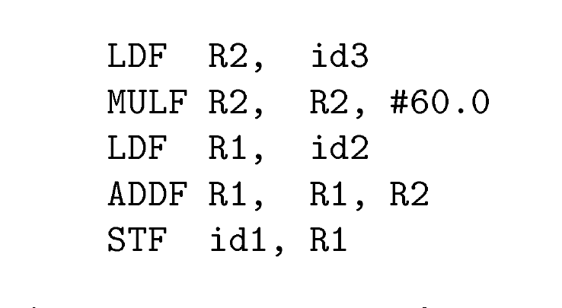
For example, using registers R1 and R2, the intermediate code might get translated into the machine code

Slide 22
Code generation example in details
The first operand of each instruction specifies a destination.
The F in each instruction tells us that it deals with floating-point numbers.
The code is loads the contents of address id3 into register R2,
then multiplies it with floating-point constant 60.0.
The # signifies that 60.0 is to be treated as an immediate constant.
The third instruction moves id2 into register R1 and
the fourth adds to it the value previously computed in register R2.
Finally, the value in register R1 is stored into the address of id l , so the code correctly implements the assignment statement.

Slide 23
